Slide 1


ARM Processor and applicationS
15EECC207

Slide 2

B-DIV
TEAM 12
TEAM 12
Name | USN
ABHINAV S P | 01FE21BEC087
SATWIK D B | 01FE21BEC088
KATYAYANI K K | 01FE21BEC092
RAJANI E G | 01FE21BEC095

Slide 3
Optimization techniques
Early loop breaking
Look up tables

Slide 4
Optimization technique-1 Early loop breaking
Early loop breaking is the process where we optimize a program such that we reduce the number of iterations by breaking the loop as soon as favorable condition is achieved .This increases execution speed and reduces the overheads associated with loops.

Slide 5
Code (Unoptimized)
//Linear search
#include<stdio.h>
void linear_search(int array[],int n,int key)
{
int flag=0;
for(int i=0;i<n;i++)
{
printf("iteration number: %d\n",i);
if(array[i]==key)
{
printf("%d found at index %d\n",key,i);
flag=1;
}
}
if(flag==0)
printf("%d is not present in the array\n",key);
}
void main()
{
int array[]={3,5,7,1,6,8,4,2,9};
int n=sizeof(array)/sizeof(array[0]);
int key=4;
linear_search(array,n,key);
}
//Unoptimized code (linear search): here loop runs for all the conditions and does not break even when the key element is found. It keeps on searching the key element till the end even if it was found in any of the previous iterations

Slide 6
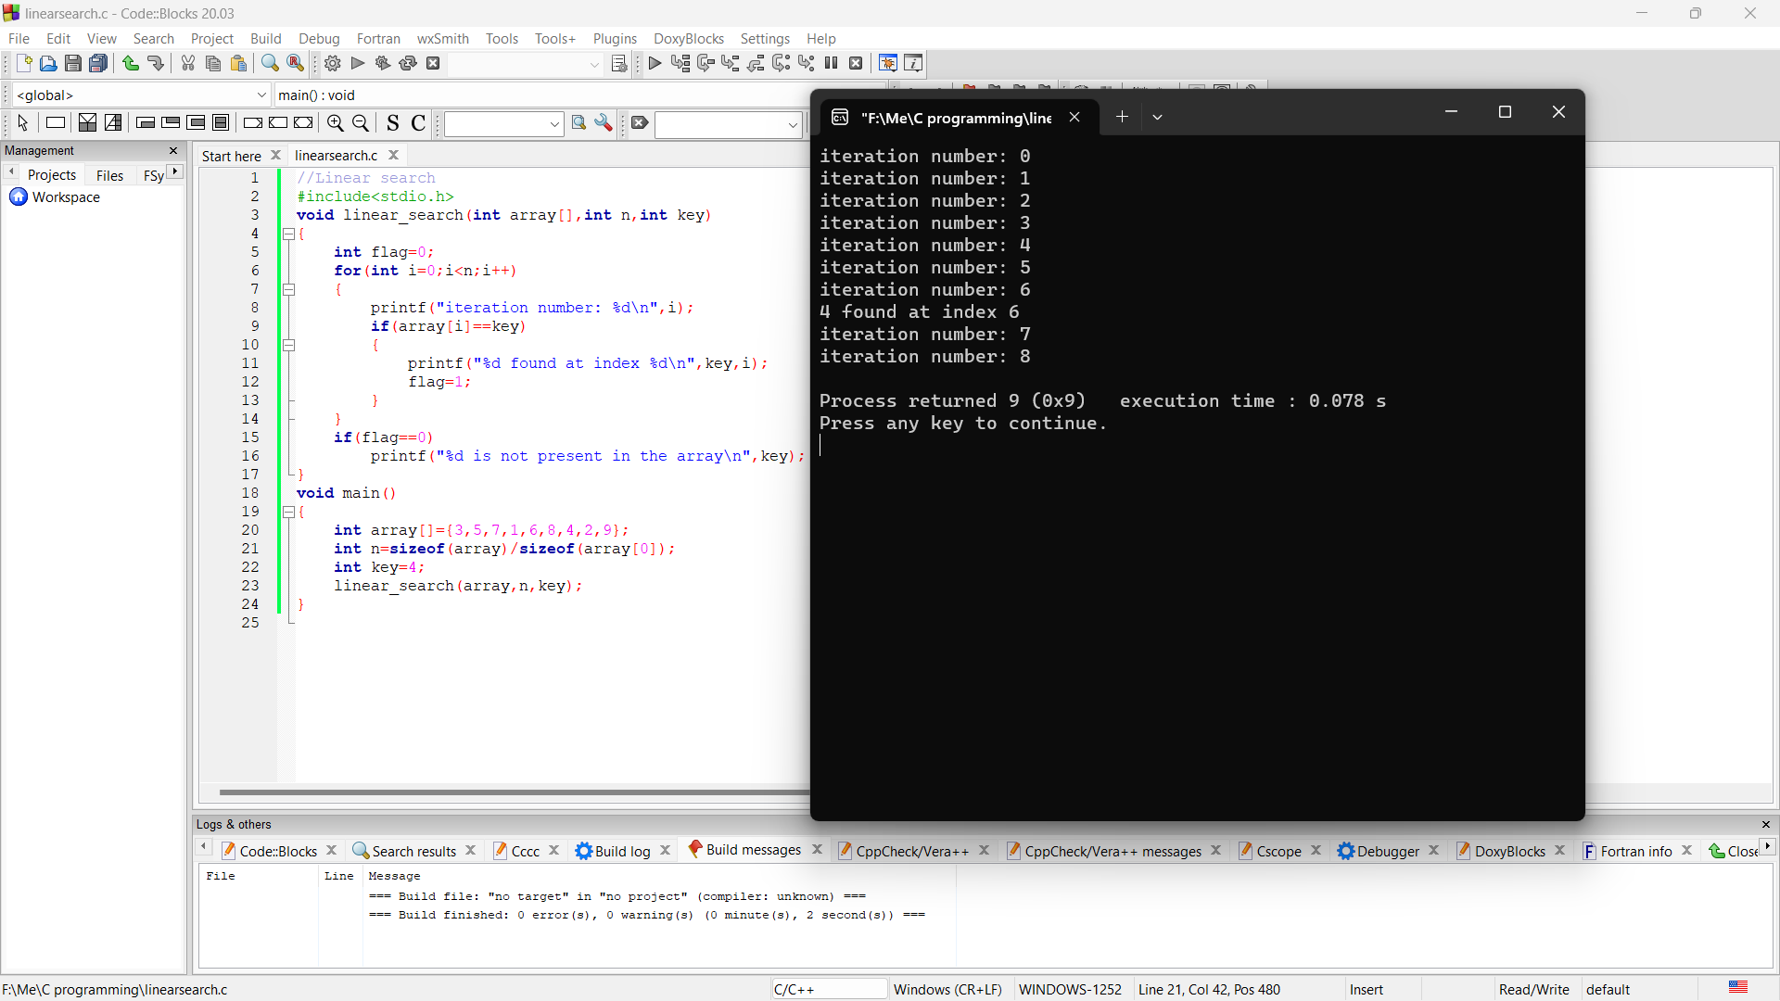
OUTPUT

Slide 7
Code (optimized)
//Linear search
#include<stdio.h>
void linear_search(int array[],int n,int key)
{
int flag=0;
for(int i=0;i<n;i++)
{
printf("iteration number: %d\n",i);
if(array[i]==key)
{
printf("%d found at index %d\n",key,i);
flag=1;
break;
}
}
if(flag==0)
printf("%d is not present in the array\n",key);
}
void main()
{
int array[]={3,5,7,1,6,8,4,2,9};
int n=sizeof(array)/sizeof(array[0]);
int key=4;
linear_search(array,n,key);
}

Slide 8
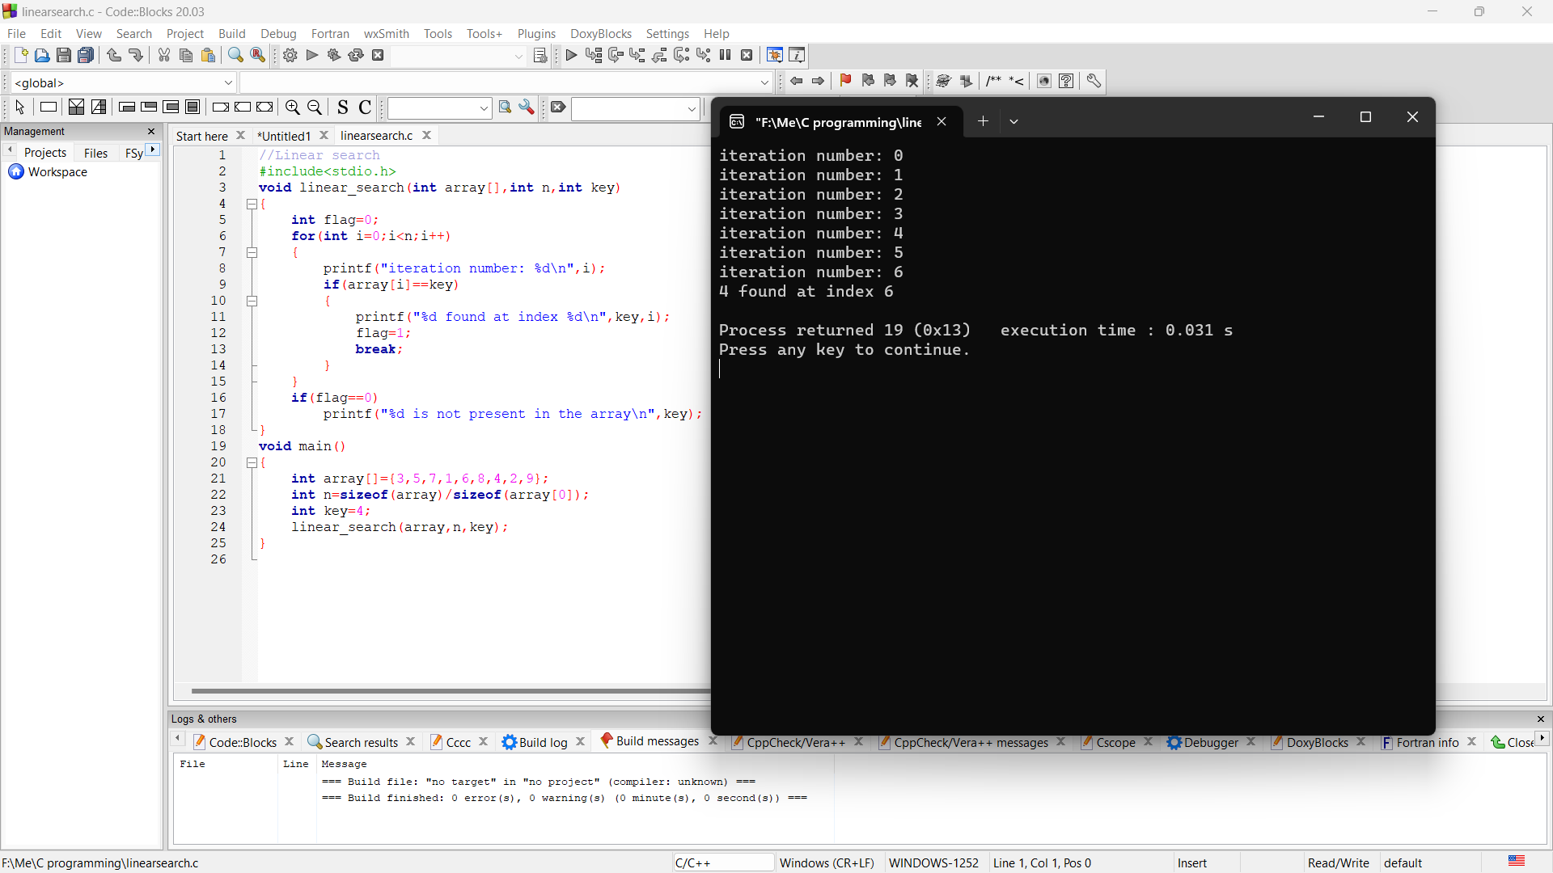
OUTPUT

Slide 9
Early loop breaking
 | TIME | MEMORY
UNOPTIMIZED | 0.078 s | 4372 bytes
OPTIMIZED | 0.031 s | 4368 bytes

Slide 10
Applications of early loop breaking
High performance computing.
It plays an important role in improving cache performance and making effective use of parallel processing capabilities.

Slide 11
Optimization technique-2 look up tables
The lookup table can replace complex runtime calculations with simple lookup operations. For example, we can pre-calculate and store the output values of a complex math function in a lookup table, using the input arguments as keys. Then, we query the table instead of calculating values.

Slide 12
Code (Unoptimized)
//Decimal to binary by calculating during execution
#include<stdio.h>
int decimal_to_binary (int);
main()
{
int binary;
int lowerlimit=0,upperlimit=15;
for(int i=lowerlimit;i<=upperlimit;i++)
{
binary=decimal_to_binary(i);
printf("Decimal = %d\tBinary = %d \n",i,binary);
}
}
int decimal_to_binary (int dec)
{
int bin=0, p=1, rem;
while(dec>0) //or d!=0
{
rem=dec%2;
bin=bin+rem*p;
dec=dec/2;
p=p*10;
}
return (bin);
}
//Unoptimised code for lookup table - value for each conversion is being calculated by the system during execution

Slide 13
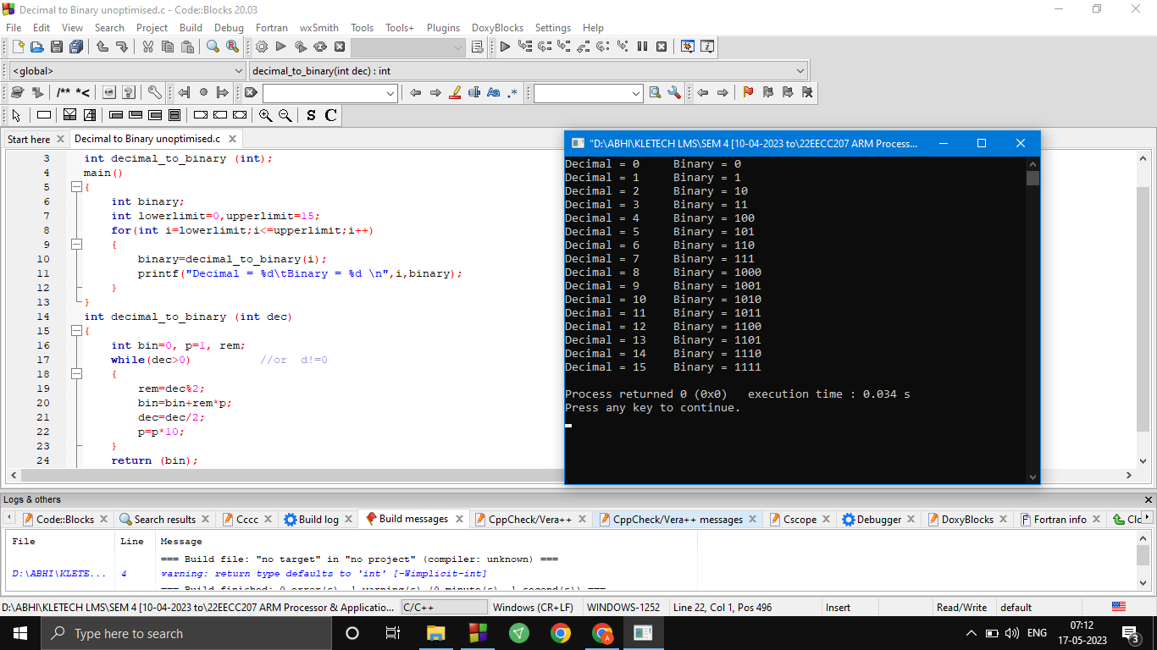
OUTPUT

Slide 14
Code (optimized)
#include<stdio.h>
const char *bin[]=
{
"0000","0001","0010","0011","0100","0101","0110","0111",
"1000","1001","1010","1011","1100","1101","1110","1111"
};
void display(int max)
{ int i;
for(i=0;i<max;i++)
{
printf("Decimal = %d\tBinary = %s \n",i,bin[i]);
}
}
int main()
{
int max=sizeof(bin)/sizeof(char *);
display(max);
}

Slide 15
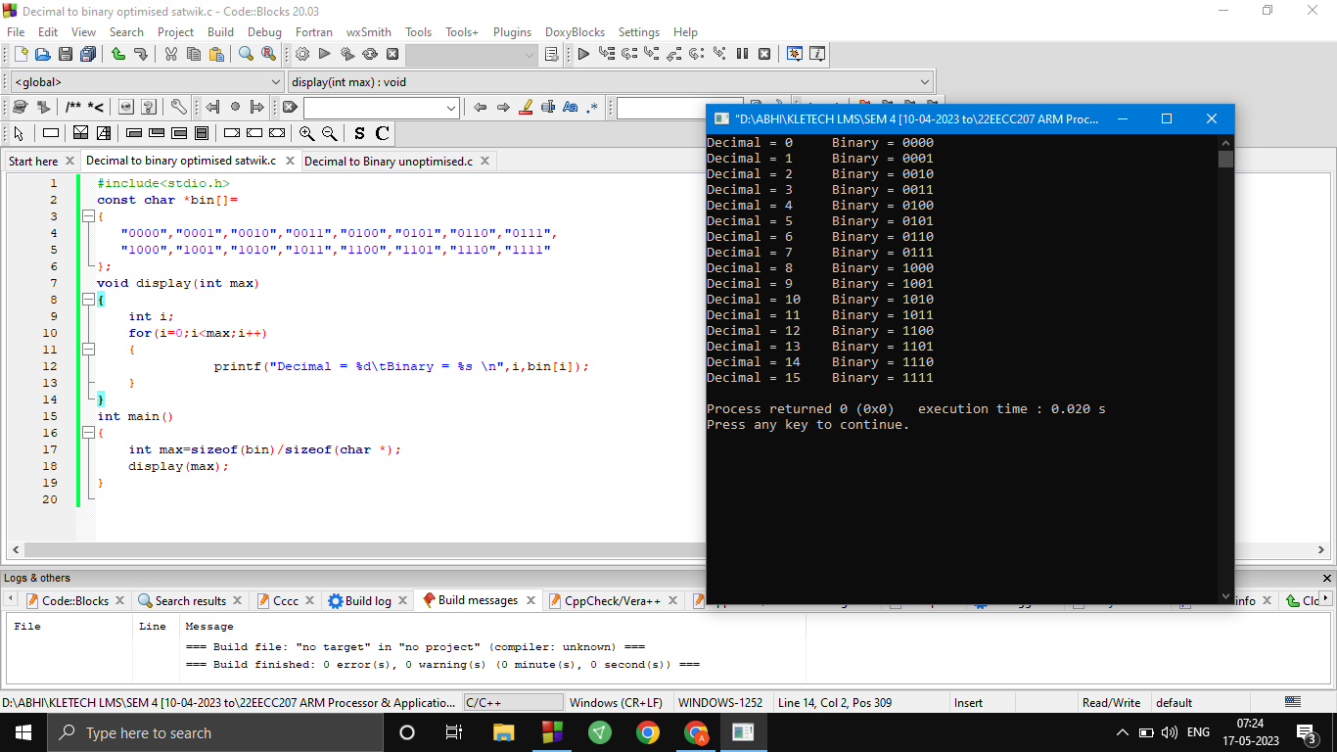
OUTPUT

Slide 16
look up tables
 | TIME | MEMORY
UNOPTIMIZED | 0.034 s | 4140 bytes
OPTIMIZED | 0.020 s | 4432 bytes

Slide 17
Applications of look up table
This technique has a wide range of applications such as :
In data analysis applications, such as image processing, a lookup table (LUT) is used to transform the input data into a more desirable output format. For example, a grayscale picture of the planet Saturn will be transformed into a color image to emphasize the differences in its rings.
A classic example of reducing run-time computations using lookup tables is to obtain the result of a trigonometry calculation.
Data acquisition and control systems.

Slide 18
Thank you
.

